Slide 1


Slide 2


Slide 3
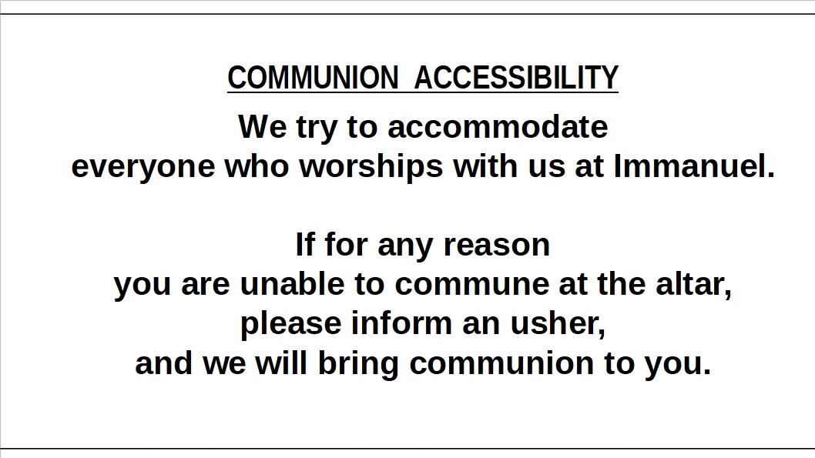

Slide 4
B
I
B
L
E
S
T
U
D
Y
“FOLLOW”
Jesus only issues an invitation to relationship
That begins with a simple request: “Follow Me”.
SMP Pastor Al Kersten leads this DVD/workbook
based study by Andy Stanley, as we journey
to follow Jesus through the Gospels.
The class begins Sunday mornings at 9:15
in the adult education room.

Slide 5
B
I
B
L
E
S
T
U
D
Y
“ROOTED IN THE PREEMINENT CHRIST”
This study which is led by Pastor Erickson meets at 9:15 a.m.
in the church library – lounge.
St. Paul’s letter to the Colossians is used to guide the study and discussion.

Slide 6
B
I
B
L
E
S
T
U
D
Y
“BEING LUTHERAN”
A Youth / Adult Bible Class meets Sunday mornings at 9:15 A.M.
in the fellowship room.
This study is led by Pastor Schultz.
The class uses the book
written by Pastor Trevor Sutton of Haslett, MI.,
entitled “Being Lutheran”.

Slide 7
B
I
B
L
E
S
T
U
D
Y
“EARLY BIRD BIBLE STUDY”
This study meets Monday mornings
at 7:00 A.M. in the lighthouse room
of the Thunder Bay River Restaurant.
Pastor Erickson leads
this current study
is in the book of 1 Kings.

Slide 8
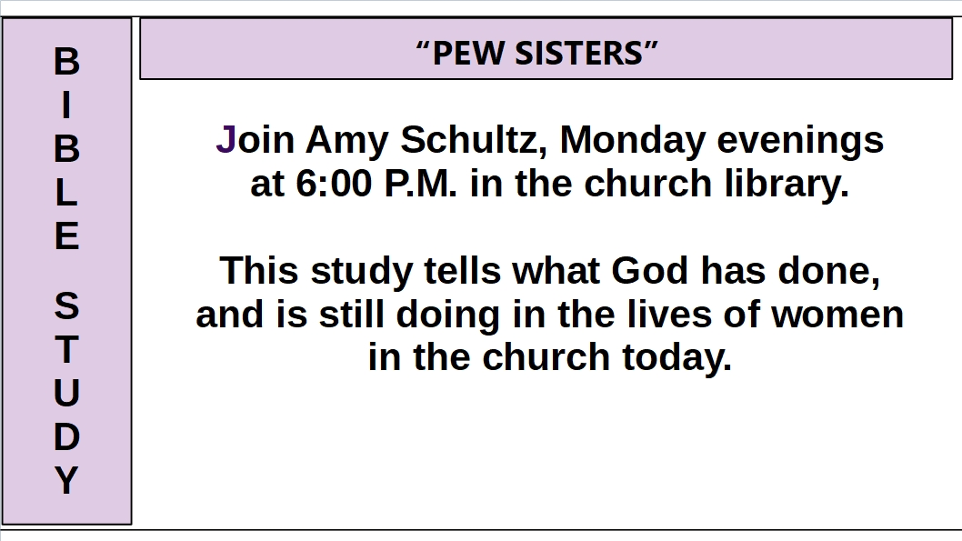

Slide 9
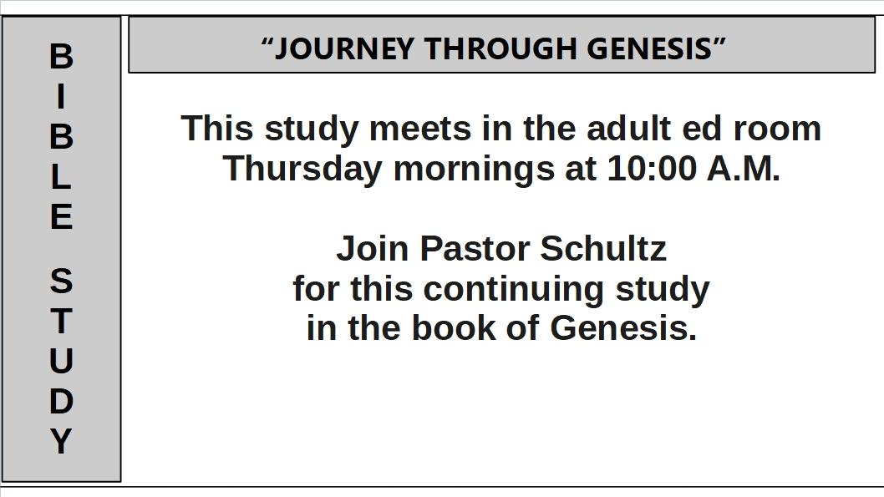

Slide 10


Slide 11
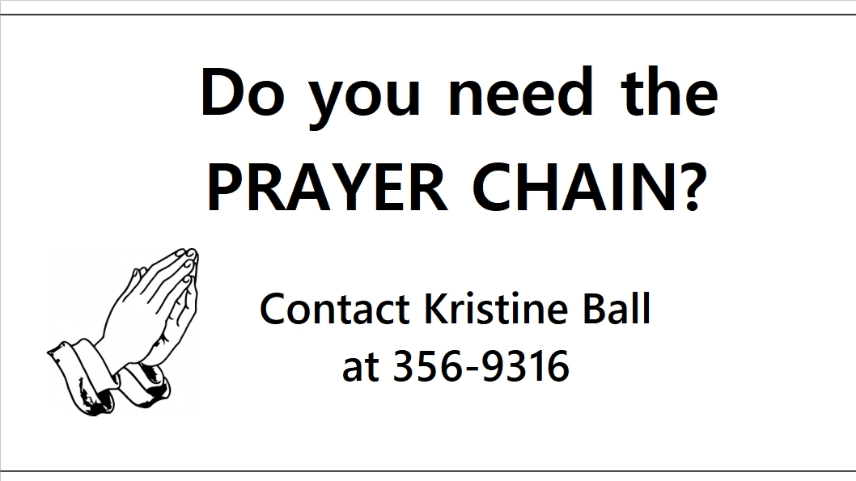

Slide 12


Slide 13
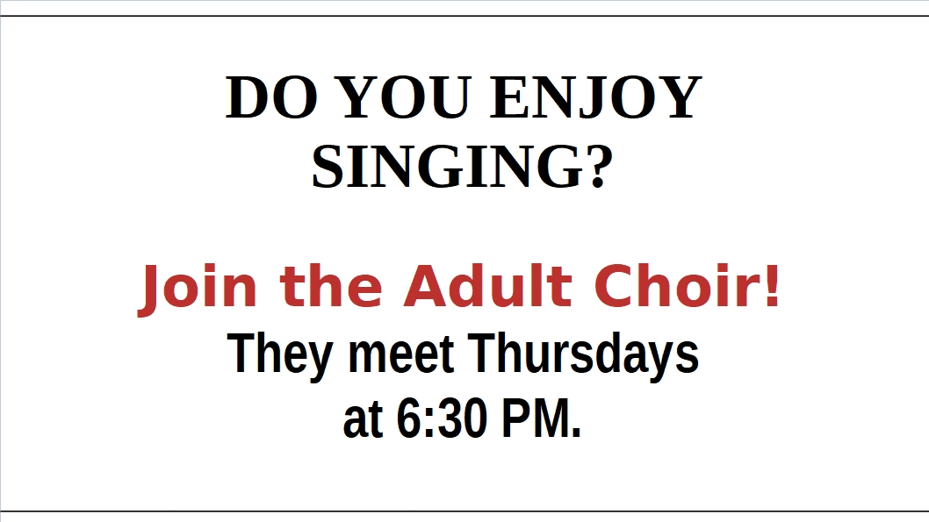

Slide 14


Slide 15


Slide 16
